Slide 1
Wire + Arc Additive Manufacturing of unalloyed tantalum
Marinelli G., Martina F., Ganguly S., Williams S.
28th International Solid Freeform Fabrication Symposium

Slide 2
Agenda
Additive Manufacturing Processes Comparison
Capability of Wire + Arc Additive Manufacturing (WAAM)
Refractory Metals Deposition
- Development of WAAM for unalloyed tungsten
- Development of WAAM for unalloyed tantalum
- Functionally graded structure molybdenum to tungsten
Conclusion

Slide 3
Additive Manufacturing Processes Comparison
Beam
Laser
Wire
Powder
Powder bed
Selective Laser Melting
Blown powder
Laser Cladding
Electron beam
Powder bed
Electron Beam Melting
Arc
TIG, MIG, Plasma
Wire
Wire+Arc AM
Wire
Sciaky
Powder
Heat sources
Cranfield University
Feedstock

Slide 4
Additive Manufacturing Processes Comparison
Note – our assessment

Slide 5
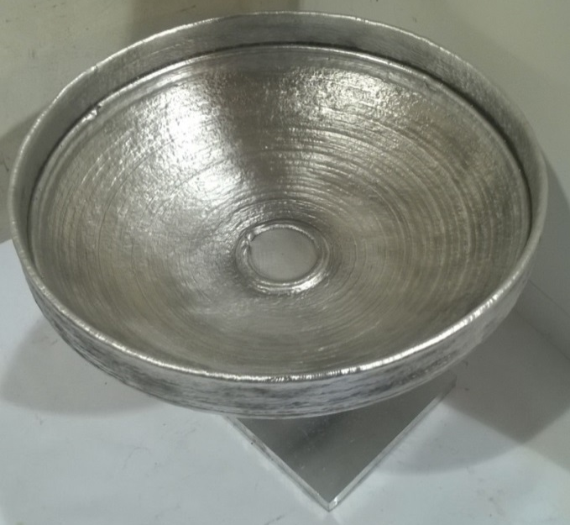

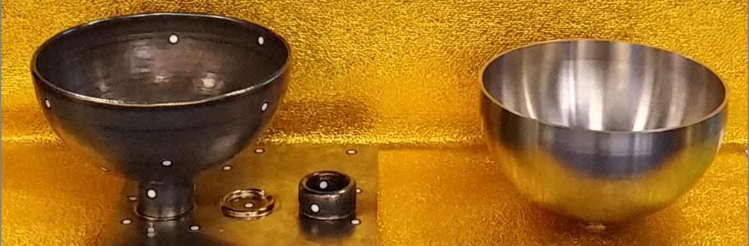
Capability of WAAM – Process
Thin wall revolving structures: ARA beanie
Building time: 2.5 hours
Wall thickness: around 5mm
Material: Al5087

Slide 6
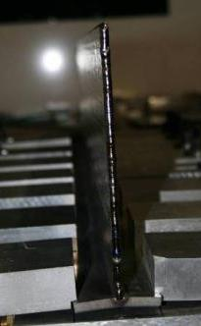
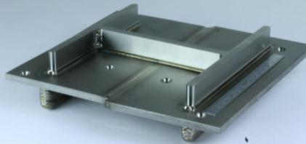
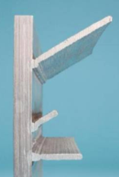
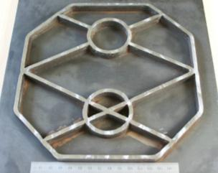
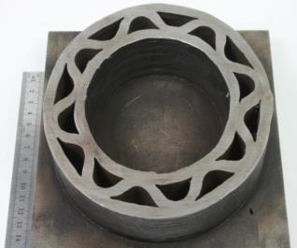
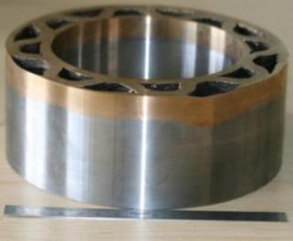
Capability of WAAM - Features
Straight near net shape Ti thin wall
Inclined torch (CMT)
Machined intersections
Angled and horizontal walls
Medium complexity 2D part
Weight efficient structure
With mixed materials

Slide 7
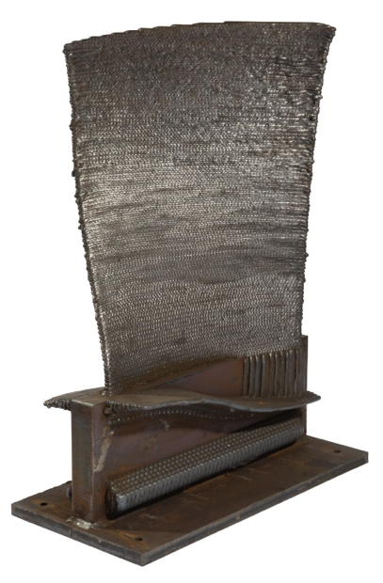
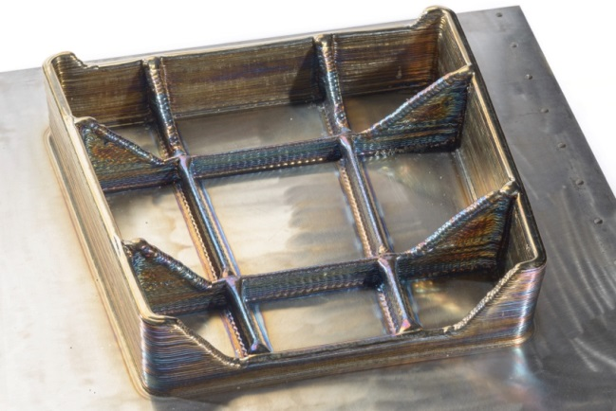
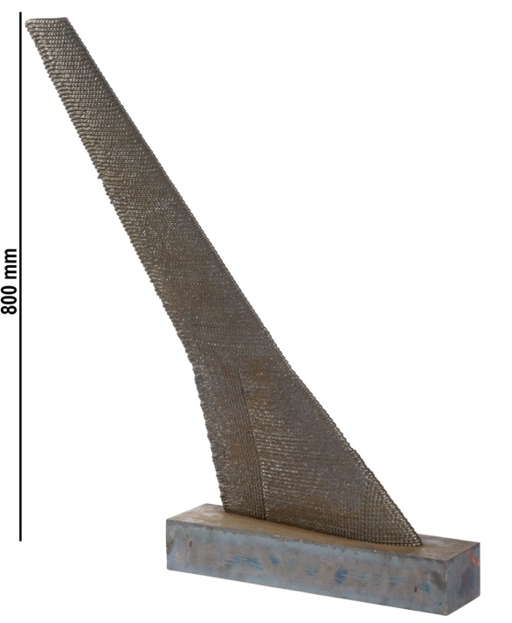
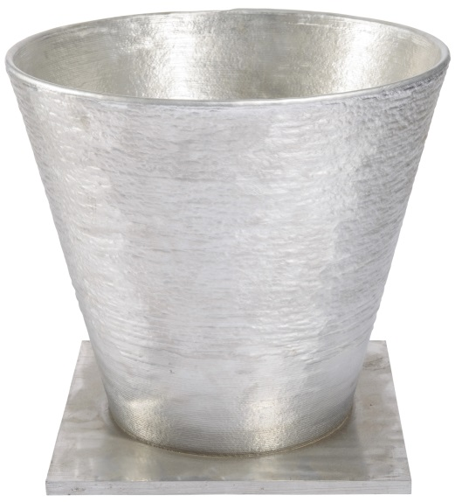
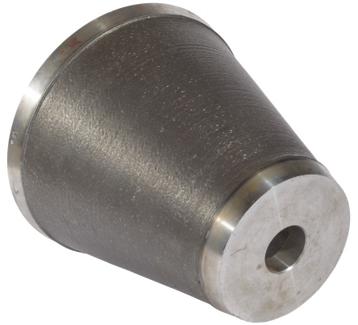
Capability of WAAM – Semi-finished parts
24 kg
1 metre
0.7 metre

Slide 8
Capability of WAAM - Materials
Ti-6Al-4V
  Grade 5
  Grade 23
Aluminium
  2024
  2319
  4043
  5087
Refractories
  Tungsten
  Molybdenum
  Tantalum
Invar
Steels
  ER60
  ER80
  ER90
  ER120
  Maraging grade 250
  Maraging grade 350
  Stainless (17-4 PH, 316L)
  Invar
Inconel
  625
  718
Bronze
Copper

Slide 9
Refractory Metals Deposition

Slide 10
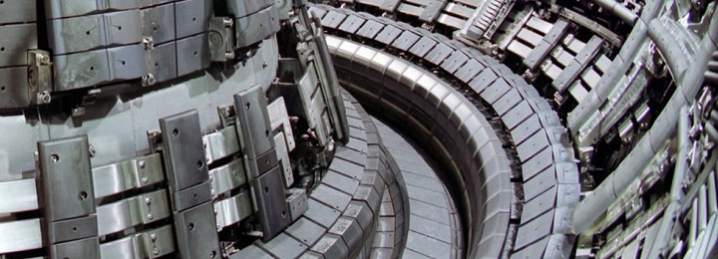
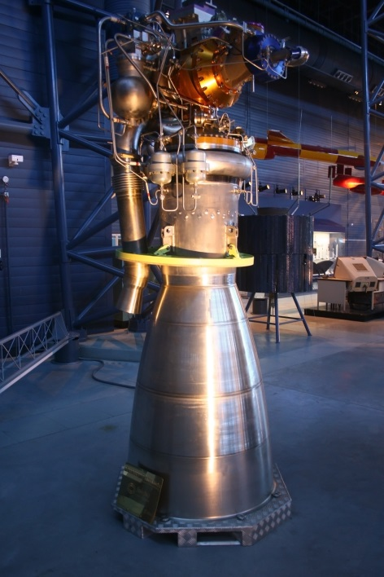
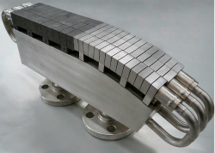
Our final aims
W
W/Mo FGS
Mo

Slide 11
Challenges of depositing refractory metals
High melting point;
High density;
Ductile-to-brittle temperature transition above room temperature.
High susceptibility to oxidation.
A completely inert atmosphere is required during deposition. A lot of heat is required to melt the feedstock and the substrate.
→
A lot of thermal stress applied to the deposit.
→
Ease of cracking.

Slide 12
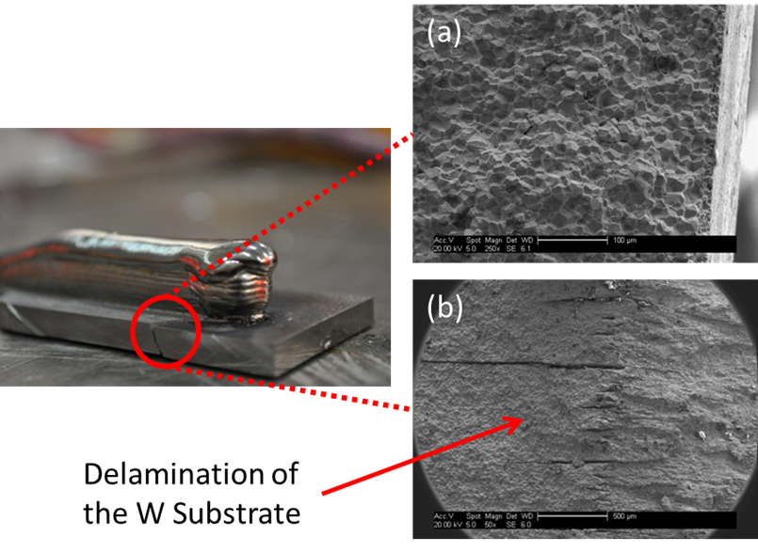
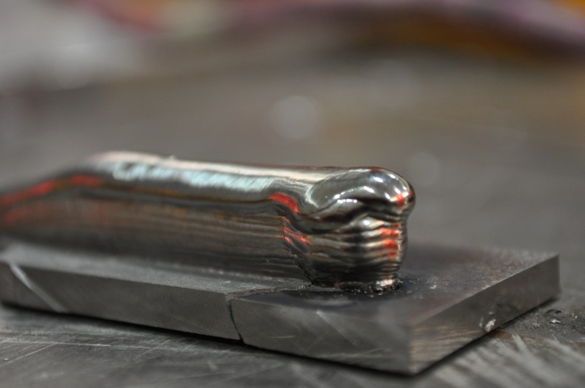
Challenges of depositing refractory metals
(brittleness of tungsten)
Tungsten Deposited
via WAAM
Tungsten Substrate
produced via Powder
Metallurgy route

Slide 13
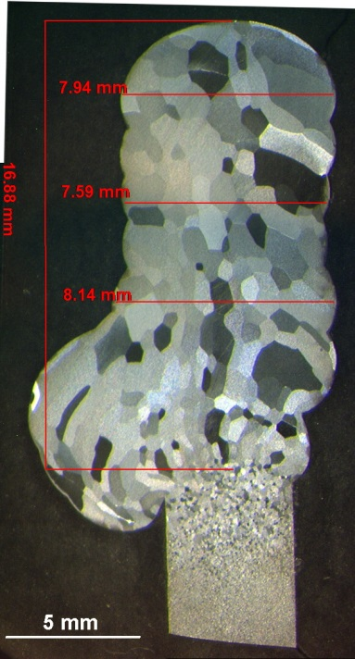
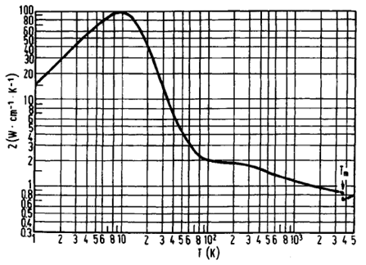

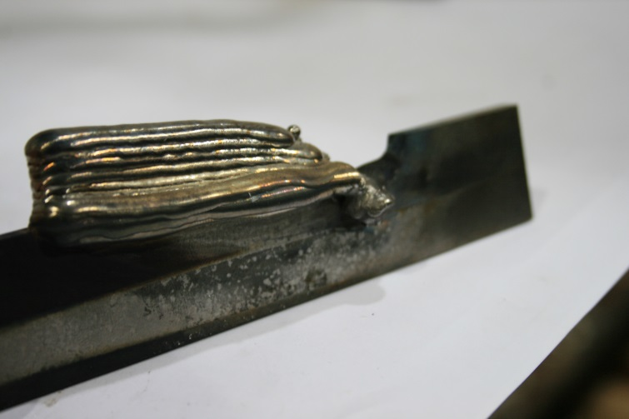
Challenges of depositing refractory metals
(managing heat accumulation)

Slide 14
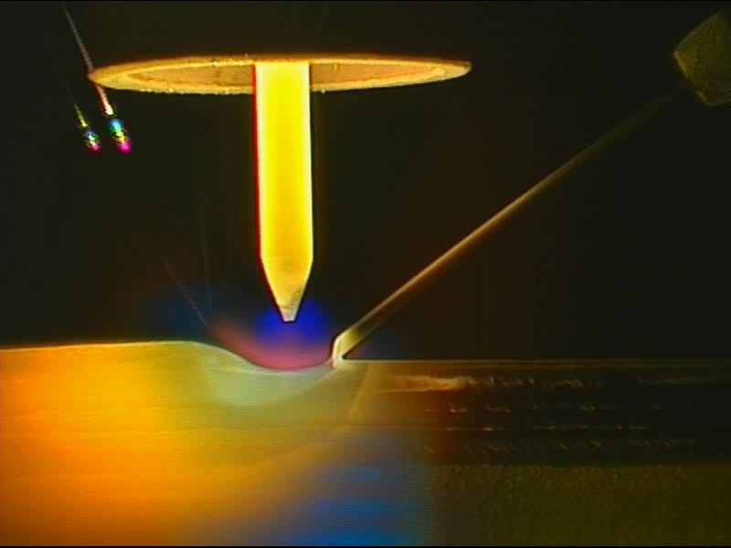
Development of WAAM for unalloyed tungsten

Slide 15
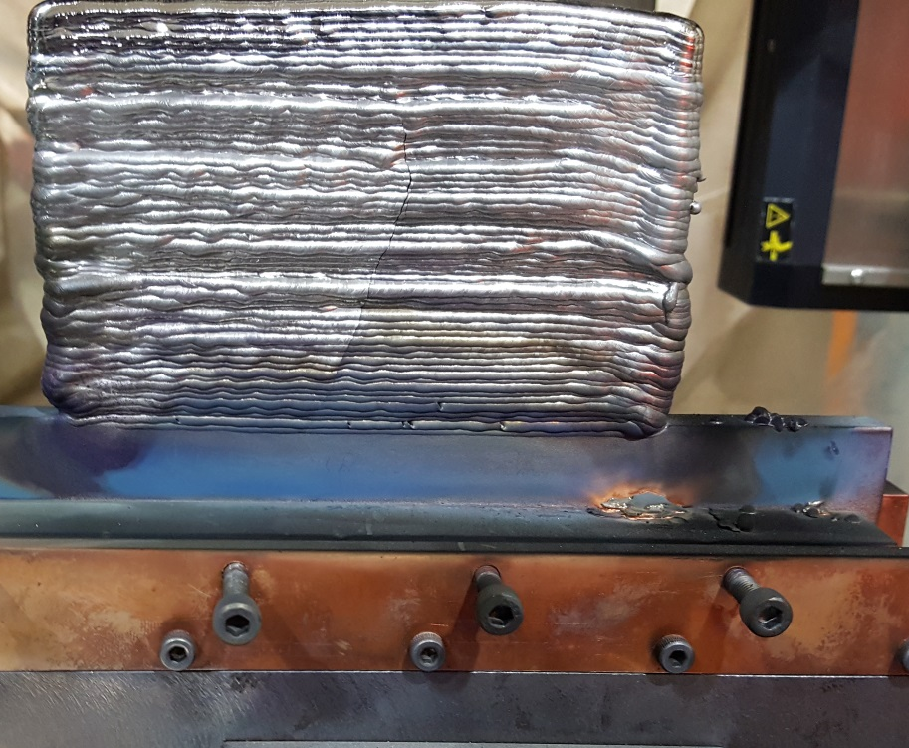
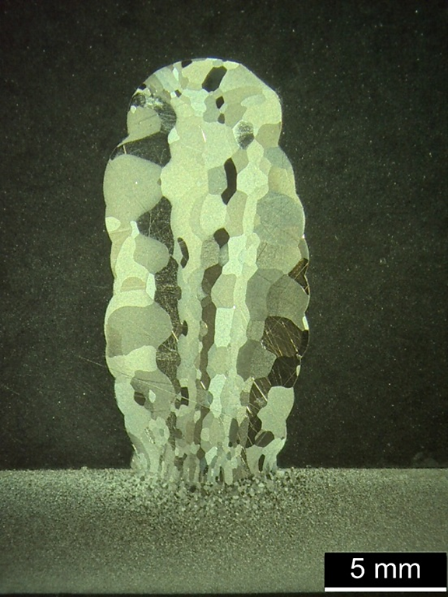
Development of WAAM for unalloyed tungsten
Sound deposition
achieved with ~
6.1 kJ/mm
Deposition rate:
2.7 kg/h
80 mm
120 mm
First structure ever in unalloyed tungsten using WAAM
Absence of cracks
Absence of oxidation
Tungsten WAAM Deposition Parameters
Wire feed speed (WFS) | 35 mm s⁻¹
Travel speed (TS) | 2 mm s⁻¹
Current (I) | 350 A
Wire diameter | 1 mm

Slide 16
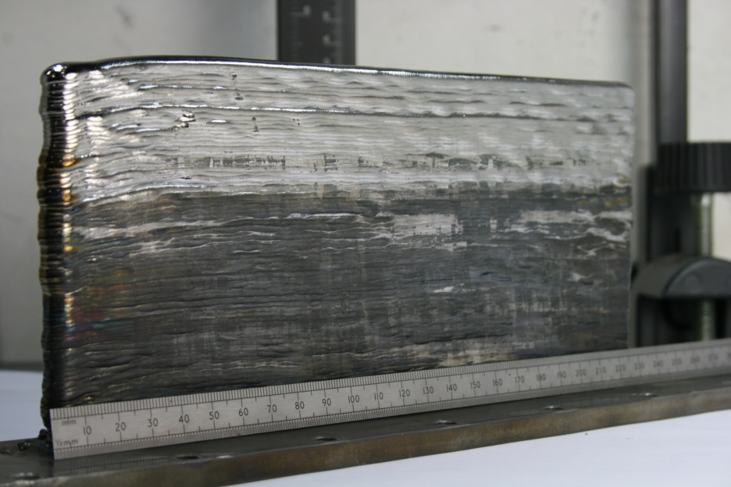
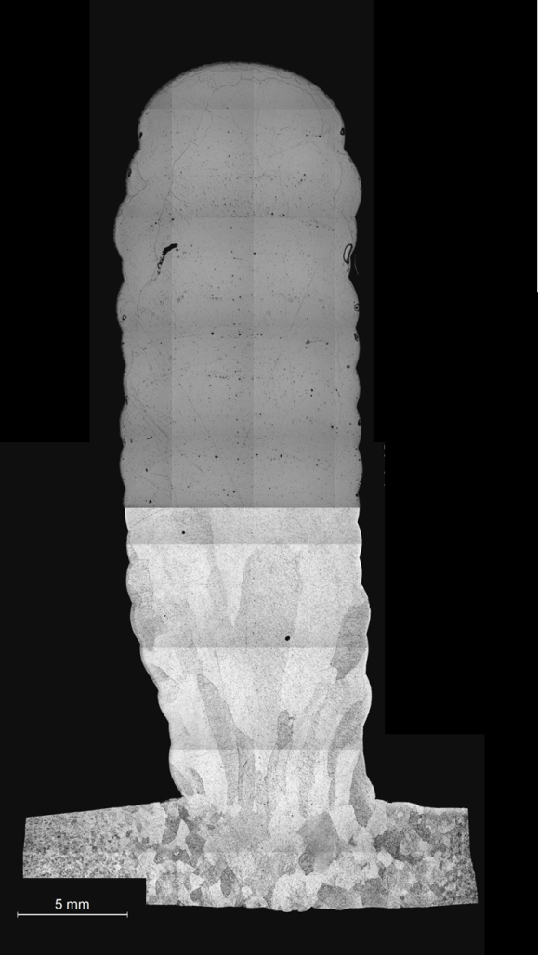
Development of WAAM for unalloyed tantalum
230 mm
Sound deposition
achieved with
~2.6 kJ/mm
Deposition rate:
4 kg/h
150 mm
First structure ever in unalloyed tantalum produced via WAAM
Tantalum WAAM Deposition Parameters
Wire feed Speed (WFS) | 60 mm s⁻¹
Travel Speed (TS) | 4 mm s⁻¹
Current (I) | 300 A
Wire diameter | 1.2 mm

Slide 17
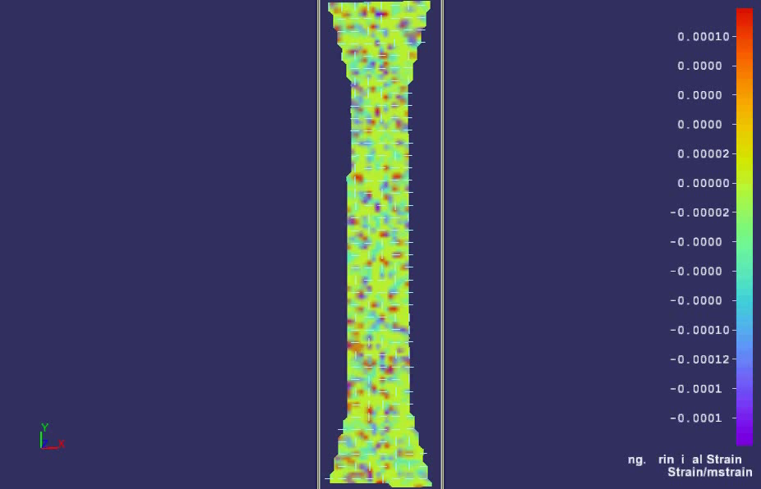
Development of WAAM for unalloyed tantalum

Slide 18
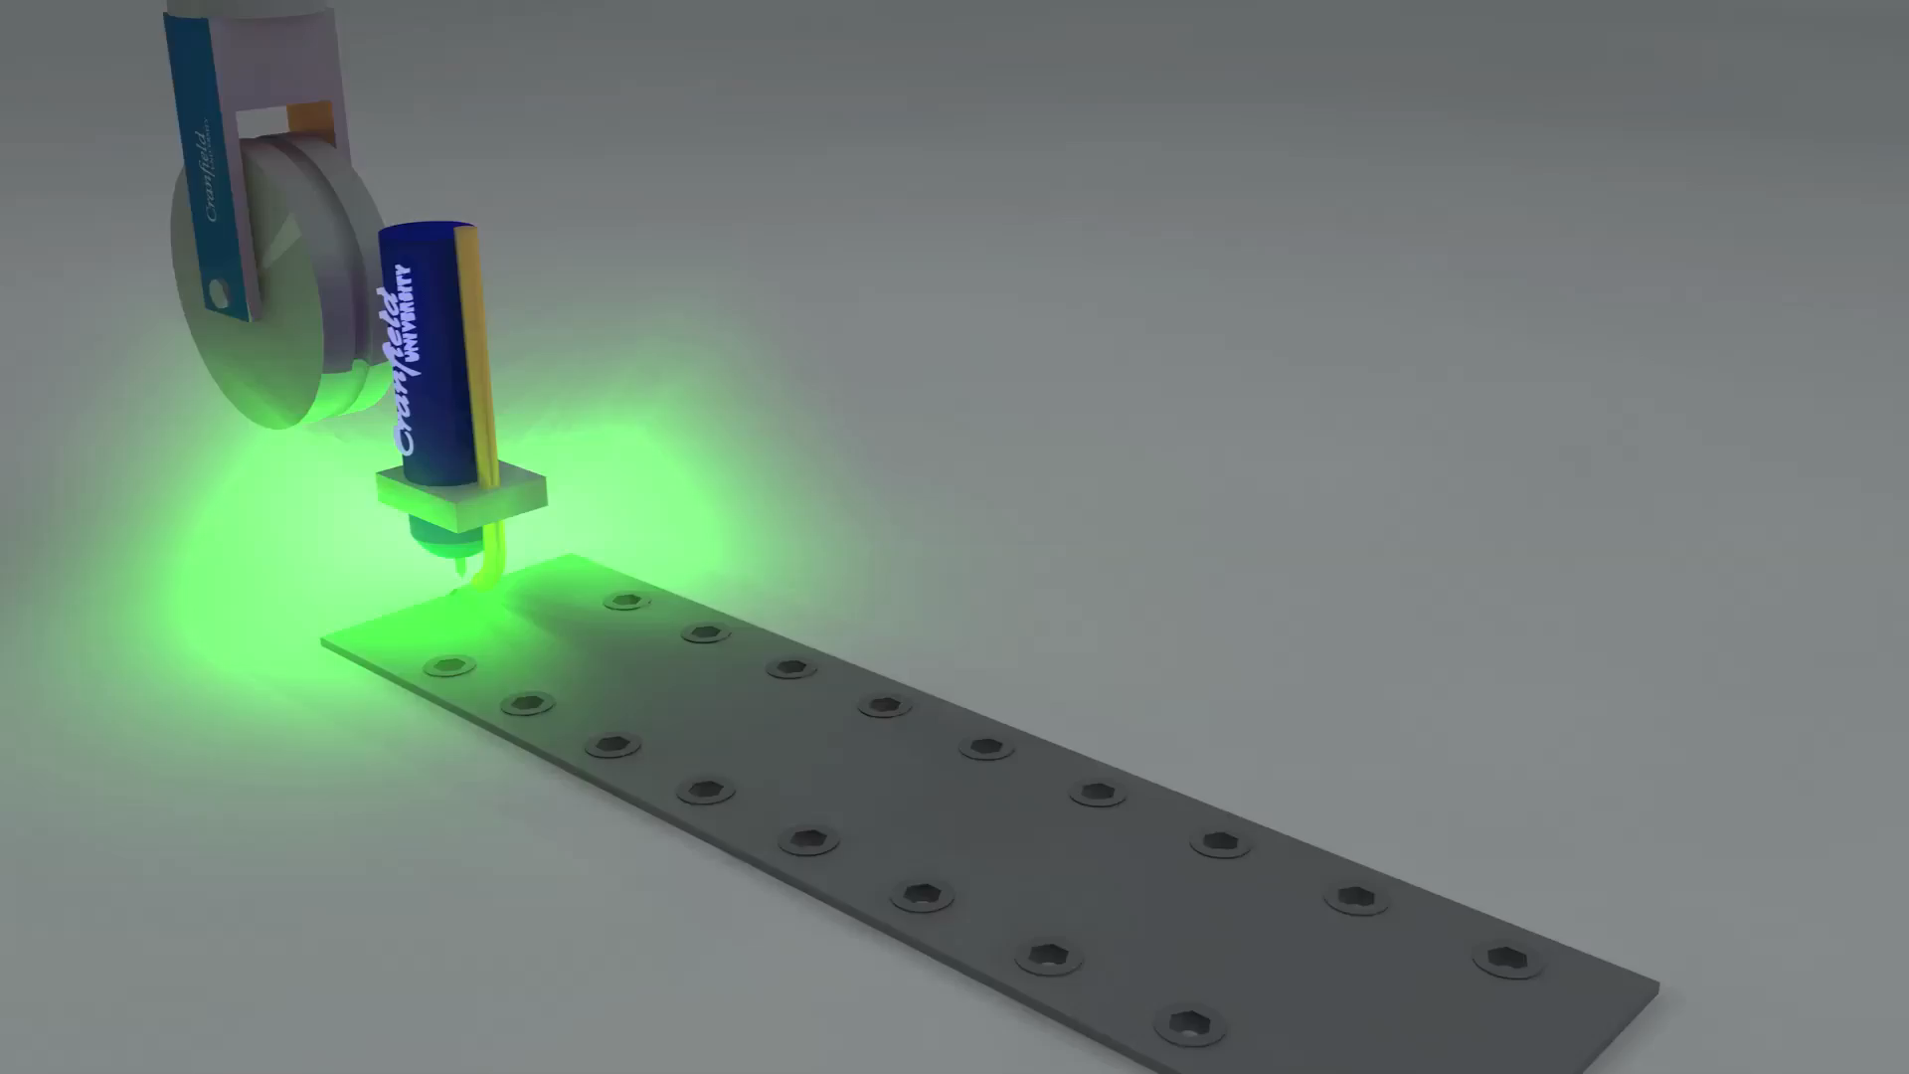
Development of WAAM for unalloyed tantalum
(high pressure rolling)

Slide 19
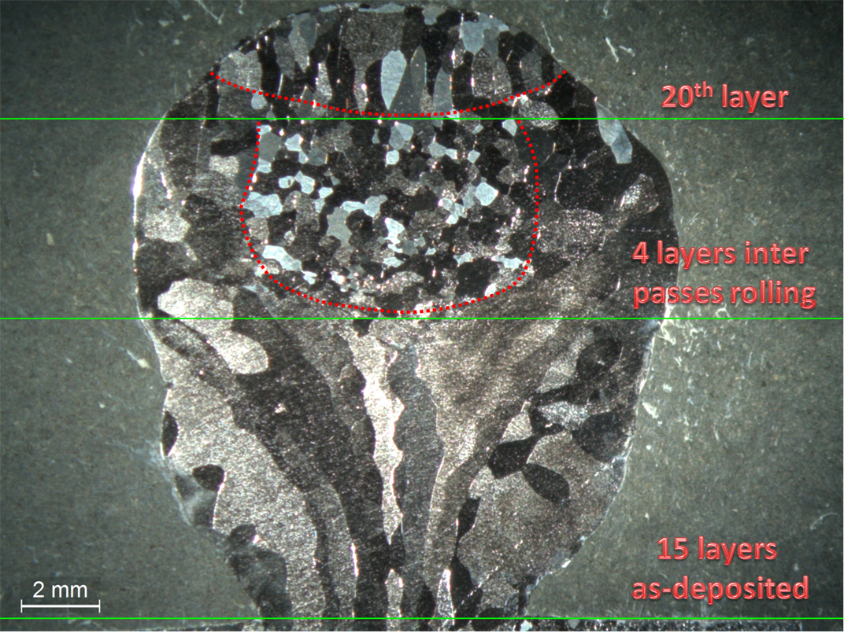
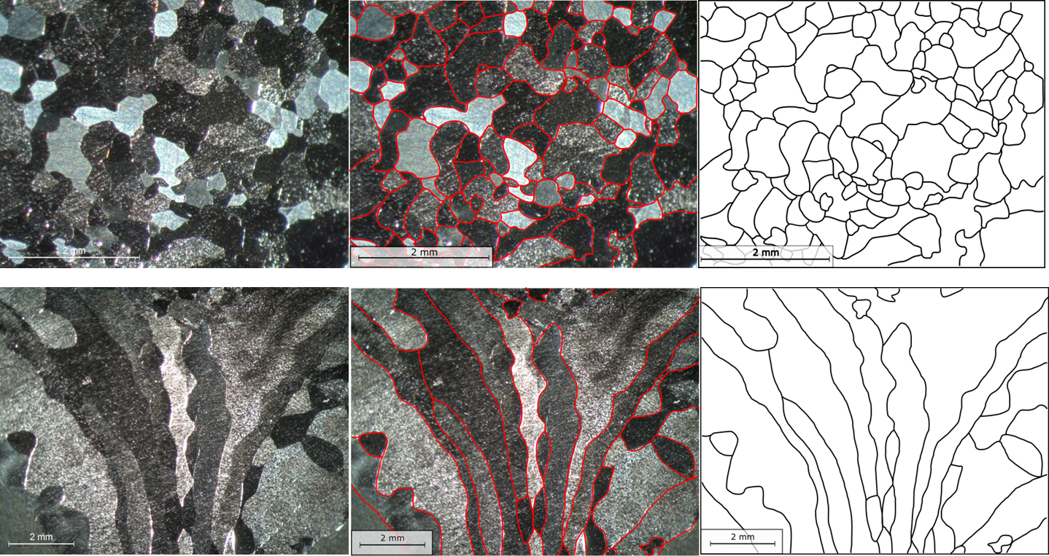
Development of WAAM for unalloyed tantalum

Slide 20
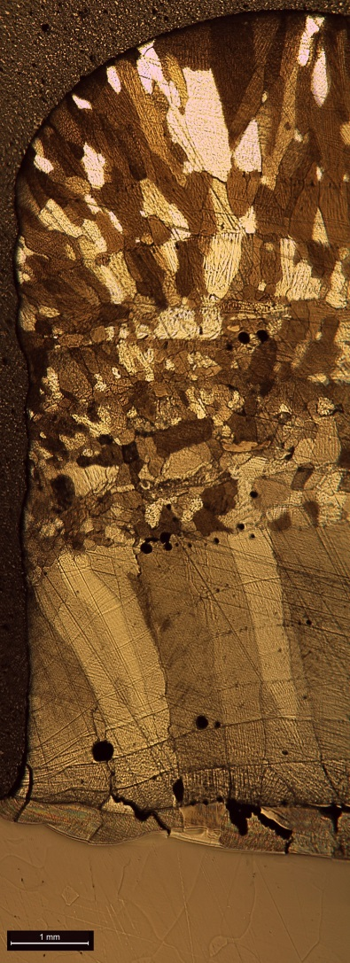

Functionally graded structure molybdenum to tungsten
W
4 mm of
gradient
thickness
Mo
Ta

Slide 21
Conclusion
WAAM is able to manufacture solid large-scale structures in refractory metals by fusion;
WAAM is able to create functionally graded structure (FGS) is a controlled way;
WAAM is able to control the evolution of the microstructure by monitoring the thermal cycles during deposition;
WAAM is able to improve and manipulate the mechanical properties using in-situ cold work;
WAAM is able to obtain a potential massive cost saving.
Future work:
Tungsten thermo-mechanical tests;
Tungsten residual stresses measurements;
Production of large parte in tantalum;
Fine tuning of the gradient of the FGS;
High-resolution DIC tensile test for the FGS.

Slide 22
Thank you for the attention
Visit our web page: waammat.com
Gianrocco Marinelli
g.marinelli@cranfield.ac.uk

